Slide 1


Final Year Project
Ehsas-Hub
Book Donation & Recommendation System
Supervised By Mr Tajamul Shahzad (lecturer)

Slide 2
Project Team
Zain Muneer 35937
Abdullah Shahid 35438
Hamza Ahmed 31967

Slide 3
Table of Content
Background and Introduction
Literature Review
Problem Statement
Proposed Solution
Requirements Summary
Design Summary
Methodology
Implementation Summary
Experiments and Results Summary
Testing Summary
Conclusion and Outlook

Slide 4
INTRODUCTION AND BACKGROUND

Slide 5
Introduction and Background
Many students today lack the financial resources and access to essential learning materials like books, which are crucial for both academic success and personal development. At the same time, numerous individuals and organizations are willing to donate books but often don't know how to reach those in need.
Ehsas-Hub is a digital platform designed to bridge this gap by connecting donors, needy, and volunteers. The primary goal of this project is to simplify the process of book donation and ensure that books reach the right recipients through a personalized recommendation system based on academic interests, and preferences.
Key Features:
Personalized Book Recommendations
Book Donation Management
User-Friendly Interface
Role-Based Dashboards

Slide 6
Literature Review and Summary Table(1/5)
Existing Research:
1. Personalized Book Recommendation System using Machine Learning Algorithm
Model Used: In this paper, K-means algorithm together with the cosine similarity measure is used to cluster the books with respect to user feedback and ratings.
Performance: The system obtained the maximum F1 Score: 74.18% for average sensitivity and specificity of 62.93% and 66.12%.

Slide 7
Literature Review and Summary Table(2/5)
2. A Literature Review on Recommendation Systems (Shraddha Gupta1)
Model Used: This paper discusses recommended systems based on CBF, CF, as well as hybrid systems, with an analysis of their individual and integrated uses in Recommendation Systems.
Performance: Compared to standalone CBF and CF, hybrid systems are better in handling essential problems like data scarcity and the start-up problem by yielding better and more generalized accuracy.

Slide 8
Literature Review and Summary Table(3/5)
3. BOOK RECOMMENDATION SYSTEM by (Ms. Sushama Rajpurkar Ms. Darshana Bhatt)
Model Used: CBF, CF and ARM are integrated into the system for book recommendation by predicting the users’ interest.
Performance: The given system also works mostly offline as the user purchase history and ratings are used for offering appropriate items, but no quantitative measures of accuracy are given.

Slide 9
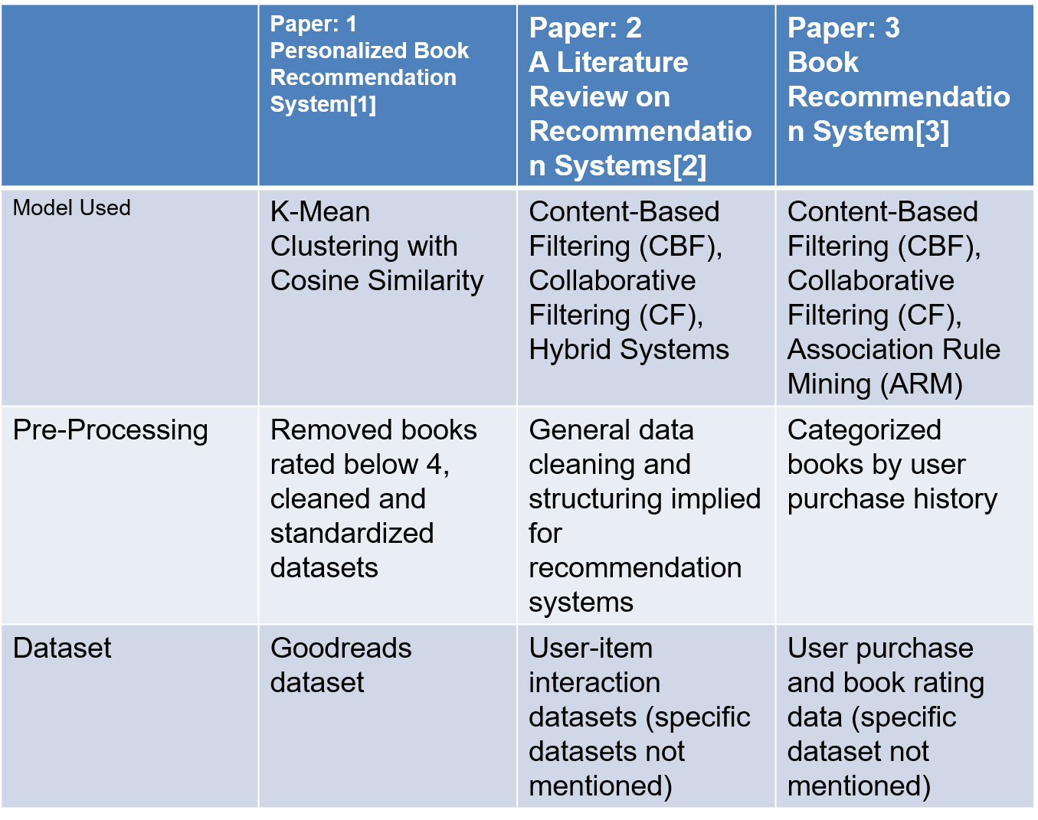
Literature Review and Summary Table(4/5)

Slide 10
Literature Review and Summary Table(5/5)
Performance | Sensitivity: 62.93%, Specificity: 66.12%, F1 Score: 65.64% | Hybrid systems improve accuracy, addressing sparsity and cold-start issues | Efficient due to offline processing; real-time performance not discussed
Limitations | - Relies on clustering quality. - Struggles with sparse datasets. | - Cold start and sparsity in CBF/CF. - Scalability issues in hybrid systems. | - Offline processing limits real-time adaptability. - Sparse datasets pose challenges. - Limited dataset diversity.

Slide 11
PROBLEM STATEMENT

Slide 12
Problem Statement
Cold-Start Problem: New members who have little or no historical information are problematic for personalized recommendations.
Data Sparsity: Lack of user or item interaction data can lead to poor recommendations, particularly in collaborative filtering techniques.
Limited Personalization: Most recommendation systems fail to well-personalize their suggestions with respect to precise academic interests, objectives, or user preferences.

Slide 13
Proposed Solution

Slide 14
Proposed Solution 1/2
Using content-based filtering with BERT-generated genre embeddings to capture semantic meaning of books.
Applying KMeans clustering to group similar books by genre.
Recommending books from relevant clusters based on new users stated preferences even without interaction history.
Generating synthetic/fake user profiles and interactions to augment limited real data.
Using Neural Collaborative Filtering (NCF) that learns latent user and book features, allowing the model to generalize preferences beyond sparse data points.
Training the NCF model on positive and negative user-book interactions to predict personalized preference scores.
Combining collaborative filtering scores with genre-based clustering to refine recommendations and enhance relevance to individual user tastes.
A unified portal connecting donors, volunteers, and needy students to streamline book donation, matching, and distribution processes efficiently.

Slide 15
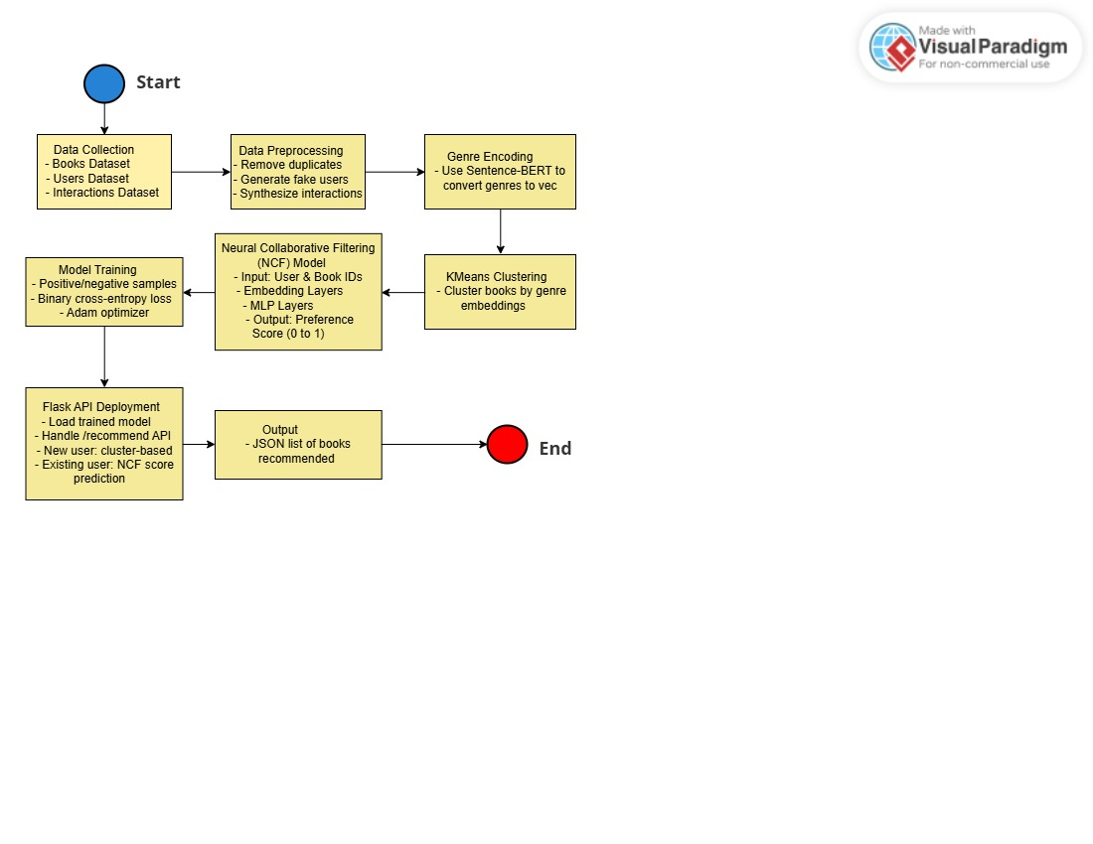
Proposed Solution 2/2

Slide 16
Requirement Summary

Slide 17
Requirement Summary
User Registration & Authentication (Admin, Donor, Volunteer, Needy)
Book Donation Management (Upload, Verify, Track)
Book Request Management
Personalized Book Recommendation System (based on interests & academic goals)
Volunteer Coordination & Task Management
Feedback Module
OTP Verification for Secure Login
Admin Dashboard for Monitoring & Management

Slide 18
Design Summary

Slide 19
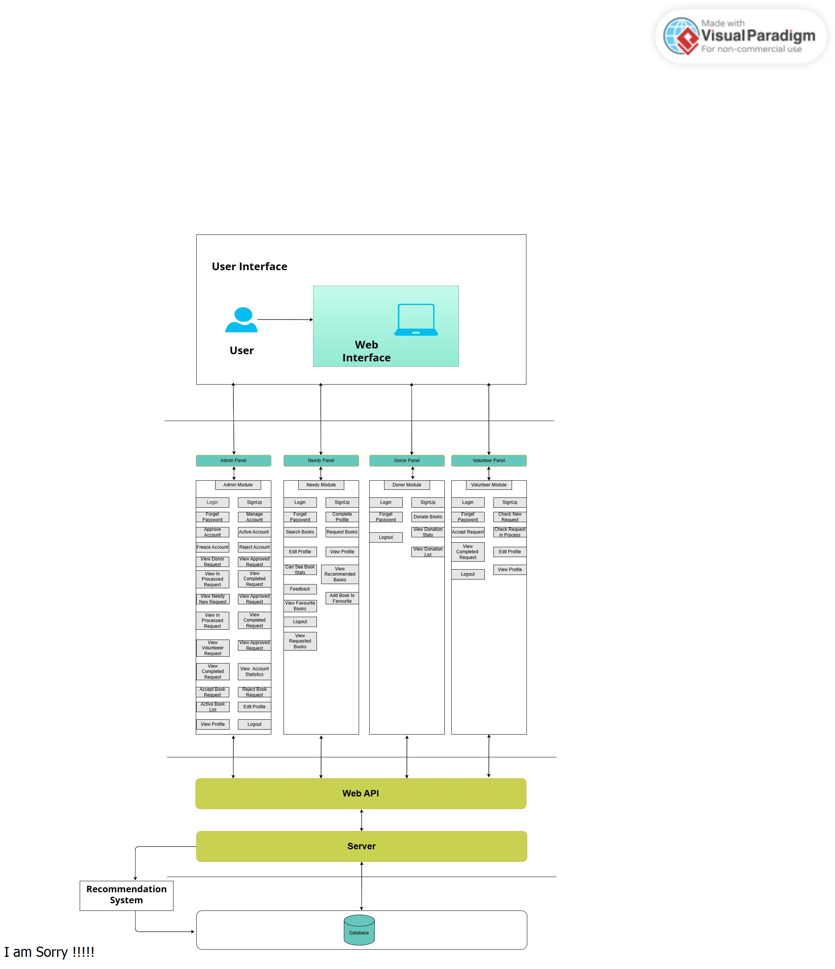
Design Summary

Slide 20
Methodology

Slide 21
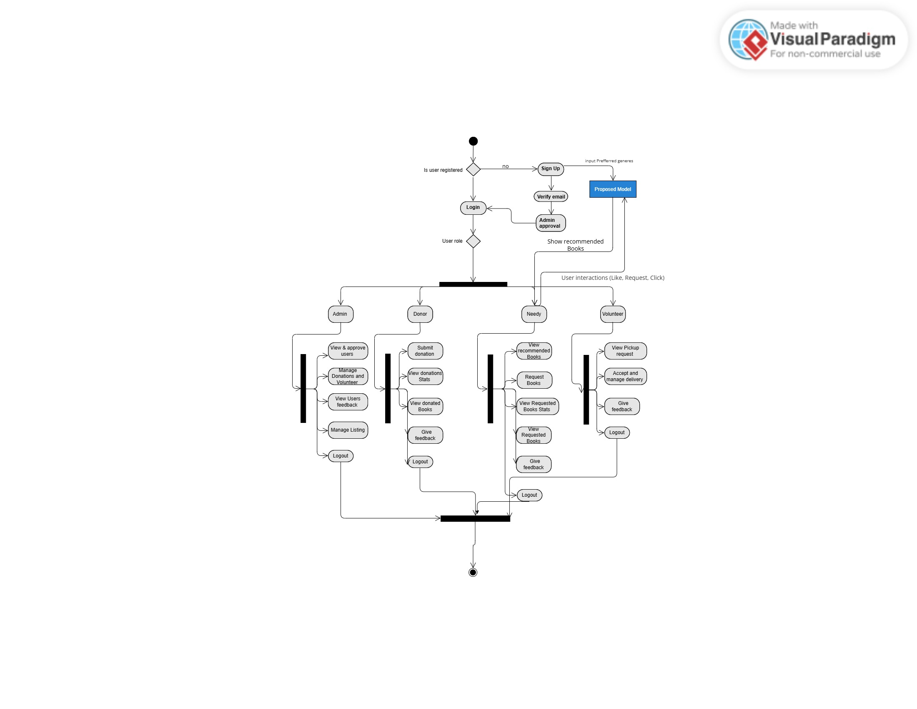
Methodology Diagram

Slide 22
Implementation

Slide 23
Implementation 1/2
List Development Tools & Technologies
Frontend: React.js, Bootstrap
Backend: Node.js Express (Restful API’s)
Database: MySQL (for secure and efficient data storage).
Programming Languages: Python, JavaScript
Machine Learning: TensorFlow / Keras, Scikit-learn, Sentence Transformers (BERT Embeddings), Google Collab.
Version Control: GitHub

Slide 24
Implementation 2/2
Utilities and Other libraries:
Bcrypt: for password hashing.
Dotenv: for environment variable management.
CORS: for cross-origin security.
Body-parser: for request body parsing.
JWT: for stateless authentication.

Slide 25
Experiments and Results Summary

Slide 26
Experiments and Results Summary 1/4
Functional Performance Evaluation
Environmental tools
Device Used: Dell Latitude Laptop
Specifications: 16gb Ram 512 SSD Core i5 8th gen
Network: 4G , Nayatel Wi-Fi
Internet Speed: 3-5 Mbps
Software: Ehsas-Hub Web Application (Mobile responsive)

Slide 27
Experiments and Results Summary 2/4
Functional Performance Evaluation
Test Procedure | Action | Expected Time | Actual Time | Result | Notes
Account Registration | Sign up with details, genre, and email OTP | ≤ 5 sec | 6 sec | 90% | Network dependent
Admin Account Approval | Admin dashboard accepts new users | Instant | Instant | 100% | Works as intended
Login | Enter email/password | ≤ 5 sec | 3 sec | 100% | Secure and smooth
Donate Book | Fill form and submit book | ≤ 5 sec | 5-6 sec | 90% | Image upload takes time
Request Book | Choose and request a book | ≤ 5 sec | 4 sec | 100% | Success confirmation email
Volunteer Accept Request | Volunteer accepts pickup nearby | ≤ 3 sec | 3-4 sec | 95% | Needs location optimization
View Recommended Book | Browse all books | ≤ 4 sec | 3 sec | 100% | Smooth rendering
Edit Profile / Logout | Update info / logout | ≤ 3 sec | 2 sec | 100% | No issues found

Slide 28
Experiments and Results Summary 3/4
Recommendation System Evaluation
Environment & Tools
Libraries Used: pandas, numpy ,flask, tensorflow, sentence-transformers, scikit-learn, faker, tf-keras, dotenv, openpyxl, sqlalchemy, pymysql, hf_xet
Backend: Flask REST API
Database: MySQL with SQLAlchemy
Synthetic Data: User interactions generated via Faker

Slide 29
Experiments and Results Summary 4/4
Recommendation System Evaluation
Test Component | Action | Expected Outcome | Actual Outcome | Accuracy | Notes
Genre-based Suggestions | Display relevant books after login | Relevant book list shown | 90% match | 90% | Based on initial signup genre
Interaction Learning | Recommend based on Search, likes, requests | Personalized suggestions | 85% accuracy | 85% | Improves over time
Response Time | Load recommendations | ≤ 5 sec | 4-5 sec | 100% | Acceptable speed under load
Cold Start Test | New user with no interactions | Genre-only based suggestions | 80% match | 80% | Initial fallback to genre model

Slide 30
Testing Summary

Slide 31
Testing Summary
Metric | Description | Value
Total Test Cases | Combined across all modules | 37
Passed | All test cases executed successfully | 37
Failed | - | 0
Test Case Effectiveness | (37/37) *100 | 100%
Defect Density | (0/37) *100 | 0%

Slide 32
ENDEAVOUR

Slide 33
Endeavour
Describe roles of your team members
Zain Muneer
Front end and back end
Documentation
Hamza Ahmed
Collection of Dataset
Preprocessing of dataset
Model Training
Documentation
Abdullah Shahid
Collection of Dataset
Documentation
Front end and Backend

Slide 34
Endeavour
Describe your software development process
1. Requirement Analysis
Objective: Identify the key functionalities and features needed by users (donors, volunteers, and admins).
Activities:
Conducted surveys and interviews with stakeholders.
Gathered requirements like intelligent matching, secure donation handling, and volunteer integration.
2. Planning
Objective: Develop a structure for project
Activities:
Assigned roles and responsibilities for tasks (frontend, backend, database development, Model Training, and documentation).

Slide 35
Endeavour
3. System Design
Objective: Define the architecture and design of the platform.
Activities:
Frontend Design: Using React.js and Bootstrap to create a responsive and user-friendly interface.
Backend Design: Plan APIs using Node.js Express for communication between the frontend and the database.
Database Design: Model the data schema in MySQL for efficient storage and retrieval of users, donations, and tasks.

Slide 36
Endeavour
Describe your way of working as a team
Clear Role Assignments: Tasks are distributed based on expertise, e.g., frontend, backend, database, Model Training and Documentation, ensuring ownership and accountability.
Structured Workflow: Modular approach with well-defined relationships between components for smooth integration and reusable code for future scalability.
Transparent Communication: Daily stand-ups and progress tracking using tools like Trello keep the team aligned and ensure milestones are met.
Efficiency Focus: Backend logic and algorithms are optimized for real-time results, ensuring fast notifications and smooth performance.

Slide 37
Work Breakdown Structure (List of all Deliverables / Strikethrough Completed Deliverables)
Project Planning
Define project goals and scope.
Select technologies and frameworks.
Create initial project timeline.
Dataset Collection & preprocessing
Dataset Collection and cleaning
Initial testing of dataset on supervised learning models.
Work on improving the accuracy for model.
Website Development
Create dashboard (login, signup, buttons).
Design and friendly user interface for book donation
Create Admin Dashboard and user statistics
Volunteer dashboard
Backend
Testing & Validation
Final Optimization
Maintenance & Documentation

Slide 38
PROTOTYPE & REPORT

Slide 39
Prototype

Slide 40
Report
Chapter 1: Introduction
Chapter 2: Literature Review / Market Survey
Chapter 3: Requirements and Design
Chapter 4: Implementation and Test Cases
Chapter 5: Experiment Results and Analysis
Chapter 6: Conclusion & Future Direction

Slide 41
Conclusion & Outlook
In conclusion, Ehsas Hub successfully met its objectives, including secure user registration, book donation workflows, multi-role access, and personalized book recommendations.
All core functionalities were implemented and tested with 100% success rate in unit testing. The project offers a scalable base for further work and meaningful social contribution.
Future directions include the expansion of features, UI improvement, integration of real-time components, and deployment for public use. With a clear roadmap for Future, Ehsas Hub stands ready for refinement and broader impact in the educational tech domain.

